Slide 1
Nyquist Stability Criterion
Continuous-time systems (review)
Discrete-time systems

Slide 2
Nyquist Stability Criterion
Full proof way of determining stability. Based on complex analysis.
Characteristic equation: 1 + D(s)G(s) = 0
Im(s)
Im(DG)
Evaluating D(s)G(s) along contour yields trajectory of magnitudes and phases.
Re(s)
Re(DG)
If no singularities (poles or zeros) of D(s)G(s) are inside the contour, then evaluation will have no encirclements of the origin.
Im(DG)
If there is a zero (and no poles) of D(s)G(s) inside a CW contour, then evaluation of D(s)G(s) around CW contour will lead to a CW encirlement of the origin.
Re(DG)

Slide 3
If there are n_{z} zeros (and no poles) of D(s)G(s) inside a CW contour, then evaluation of D(s)G(s) around CW contour will lead to n_{z} CW encirlements of the origin.
Similarly, if there are n_{p} poles (and no zeros) of D(s)G(s) inside a CW contour, then evaluation of D(s)G(s) around CW contour will lead to n_{p} CCW encirlements of the origin.
If D(s)G(s) has both poles and zeros inside a CW contour, let m_{net} be the net number of zeros inside the CW contour.
  m_{net} > 0 indicates that there are more zeros than poles inside the contour.
  m_{net} < 0 indicates that there are fewer zeros than poles inside the contour.
  Evaluation of D(s)G(s) around CW contour will lead to m_{net} CW encirclements of the origin. (If m_{net} < 0, encirclements are in the CCW direction.)

Slide 4
Want to know if roots of 1+D(s)G(s) = 0 (closed-loop poles) are inside the RHP.
Im(s)
Im(DG)
Re(DG)
Re(s)
1 : from Bode plots (DG)
2 : complex conjugate of 1
3 : |D(s)G(s)| usually is close to zero
Evaluate 1+D(s)G(s) around this contour, then determine the number of encirclements of the origin.
Equivalently, evaluate D(s)G(s) around this contour, then determine the number of encirclements of the -1 point.

Slide 5
Nyquist Stability Criterion
N = Z − P
Z = N + P
N: number of net CW encirclements of -1
Z: number of zeros of 1+D(s)G(s) in RHP = number of C. L. poles of system in RHP
P: number poles of 1+ D(s)G(s) in RHP = number of poles of D(s)G(s) in RHP = number of O.L. poles in RHP
Often, P = 0 (O.L. stable) then, Z = N .

Slide 6


Suppose P = 2, N = -2
Z =
If Z = 0, then C.L. system is stable.
If Z > 0, then C.L. system is unstable.
N can be positive or negative.

Slide 7
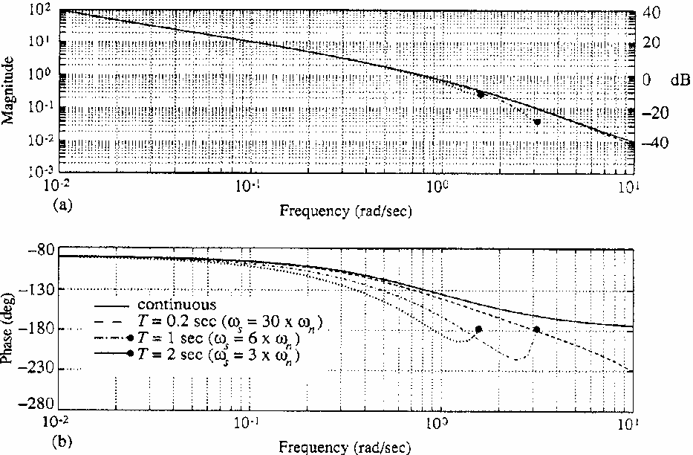
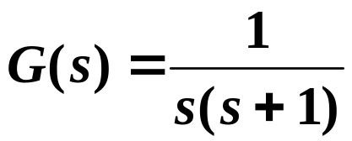






Example
D(s) = K = 1
Σ
Im(s)
Im(DG)
Re(s)
Re(DG)

Slide 8




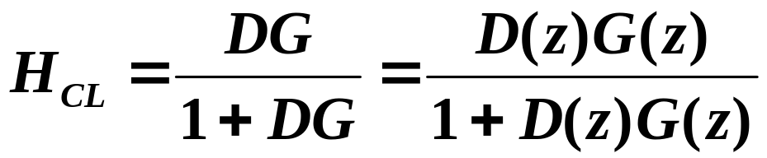

Nyquist for Discrete-Time Systems
Σ
has poles outside the unit circle.
has zeros outside the unit circle.

Slide 9

Nyquist Stability Criterion for Discrete-Time Systems
Z = N + P
N: number of net CW encirclements of -1
Z: number of zeros of 1+D(z)G(z) outside U.C. = number of C. L. poles of system outside U.C.
P: number poles of 1+ D(z)G(z) outside U.C. = number of poles of D(z)G(z) outside U.C. = number of O.L. poles outside U.C.

Slide 10
Im(z)
1
Re(z)
1 : from Bode plot
2 : complex conjugate of 1
3 : |D(z)G(z)| usually is close to zero
4 : need to evaluate
5 : complex conjugate of 4

Slide 11
Alternative Nyquist Stability Criterion for Discrete-Time Systems
Awkward to consider the unstable region of the z-plane outside the unit circle.
How about considering the stable region inside the unit circle?
Im(z)
Re(z)
1
Let n be the number of zeros of 1+D(z)G(z) = 0 (total number of closed-loop poles (stable or unstable)).
Z = P – N
N: number of net CCW encirclements of –1
= number of stable zeros – number of stable poles
= (n – Z) – (n – P) = P – Z
Z: number of zeros of 1+D(z)G(z) outside U.C.
P: number poles of 1+ D(z)G(z) outside U.C.

Slide 12
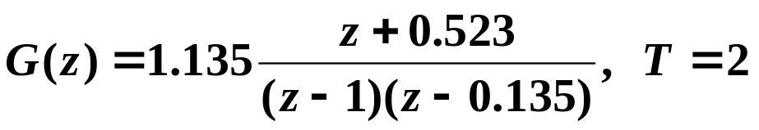
Discrete-Time Example
sec
D = K = 1 DG = G
Im(z)
Im(DG)
1
Re(z)
Re(DG)

